Slide 1
Lecture 24

Slide 2
String Handling Library
Functions defined in #include<string.h>
String handling library provides many useful functions:
Manipulate string data(copy and concatenate)
Comparing strings
Determine string length

Slide 3
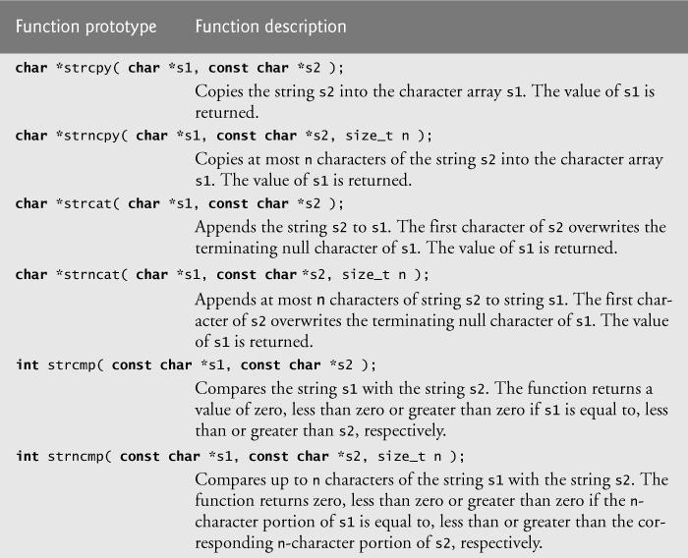
String Manipulation Functions(or Functions in string library)

Slide 4
More functions in string library
strlen()-It is used to find the length of string without counting the null character
strrev()-It is used to display the reverse of a string
strlwr()-Converting a string from upper to lower case
strupr()-Converting a string from lower to upper case

Slide 5
strcpy() and strncpy()
strcpy() copies the entire second argument string into first argument.
strcpy( s1, s2);
strncpy() copies the first n characters of second string argument into first string argument.
strncpy( s1, s2, 4);
A null character ('\0') is appended explicitly to first argument, because the call to strncpy in the program does not write a terminating null character.
The third argument is less than the string length of the second argument.

Slide 6
Examples
//strcpy() function
#include<stdio.h>
#include<string.h>
int main()
{
//strcpy function
char ori[20],dup[20];
char *z;
printf("\n Enter your name:");
gets(ori);
z=strcpy(dup,ori);
printf("Original String is:%s",ori);
printf("\nDuplicate String is:%s",dup);
printf("\n Value of z is:%s",z);
return 0;
}
//strncpy()
#include<stdio.h>
#include<string.h>
int main()
{
char str1[15],str2[15];
int n;
printf("\nEnter Source String:");
gets(str1);
printf("\nEnter Destination String:");
gets(str2);
printf("Enter number of characters to copy in destination string:");
scanf("%d",&n);
strncpy(str2,str1,n);
printf("Source string is:%s",str1);
printf("\nDestination String is:%s",str2);
return 0;
}

Slide 7
strcat()
Function strcat appends its second argument string to its first argument string.
strcat( s1, s2);
The array used to store the first string should be large enough to store
the first string
the second string and
the terminating null character copied from the second string.

Slide 8
strncat()
Function strncat appends a specified number of characters from the second string to the first string.
strncat( s1, s2, 6)
A terminating null character is automatically appended to the result.

Slide 9
Examples
//strcat
#include<stdio.h>
#include<string.h>
int main()
{
char str1[20],str2[10];
printf("\n Enter first string:");
gets(str1);
printf("\n Enter second string:");
gets(str2);
strcat(str1,str2);
printf("\n String after concatenation:%s",str1);
return 0;
}
//strncat
#include<stdio.h>
#include<string.h>
int main()
{
char str1[20],str2[10];
int n;
printf("\n Enter first string:");
gets(str1);
printf("\n Enter second string:");
gets(str2);
printf("\n Enter number of characters you want to combine:");
scanf("%d",&n);
strncat(str1,str2,n);
printf("\n String after concatenation:%s",str1);
return 0;
}

Slide 10
Comparison Functions of the String Handling Library
Comparing strings
Computer compares numeric ASCII codes of characters in string
strcmp() Compares its first string argument with its second string argument, character by character.
Function strncmp() does not compare characters following a null character in a string.

Slide 11
strcmp()
int strcmp( const char *s1, const char *s2 );
Compares string s1 to s2
Returns
a negative number if s1 < s2,
zero if s1 == s2
a positive number if s1 > s2

Slide 12
strncmp()
int strncmp( const char *s1, const char *s2, int n);
Compares up to n characters of string s1 to s2
a negative number if s1 < s2,
zero if s1 == s2
a positive number if s1 > s2

Slide 13
Examples
// strncmp
#include<stdio.h>
#include<string.h>
int main()
{
char str1[20],str2[10];
int x,n;
printf("\n Enter first string:");
gets(str1);
printf("\n Enter second string:");
gets(str2);
printf("\n Enter no. of characters to compare:");
scanf("%d",&n);
x=strncmp(str1,str2,n);
if(x==0)
{
printf("\n Strings are equal");
}
else if(x>0)
{
printf("\n First string is greater than second string(strings are not equal)");
}
else
{
printf("\n First string is less than second string(strings are not equal)");
}
return 0;
}
//strcmp
#include<stdio.h>
#include<string.h>
int main()
{
char str1[20],str2[10];
int x;
printf("\n Enter first string:");
gets(str1);
printf("\n Enter second string:");
gets(str2);
x=strcmp(str1,str2);
if(x==0)
{
printf("\n Strings are equal");
}
else if(x>0)
{
printf("\n First string is greater than second string(strings are not equal)");
}
else
{
printf("\n First string is less than second string(strings are not equal)");
}
return 0;
}

Slide 14
stricmp()[Ignore case], stricmp will ignore the case
#include<stdio.h>
int main()
{
char str1[20],str2[10];
int x;
printf("\n Enter first string:");
gets(str1);
printf("\n Enter second string:");
gets(str2);
x=stricmp(str1,str2);
if(x==0)
{
printf("\n Strings are equal");
}
else if(x>0)
{
printf("\n First string is greater than second string(strings are not equal)");
}
else
{
printf("\n First string is less than second string(strings are not equal)");
}
return 0;
}
//consider str1(HELLO) and str2(hello) and if we apply stricmp on these strings, then 0 will be returned, as strings are equal

Slide 15
Determining the length of string
strlen()
Function strlen in #include<string.h>
Function strlen() takes a string as an argument and returns the number of characters in the string
the terminating null character is not included in the length

Slide 16
Example
#include<stdio.h>
#include<string.h>
int main()
{
char str[]="Hello";
printf("\n Length of the given string is:%d",strlen(str));
return 0;
}

Slide 17
strrev()-Example
#include<stdio.h>
#include<string.h>
int main()
{
char s[100]="Hello";
printf("%s",strrev(s));
return 0;
}

Slide 18
strlwr(),strupr()-Examples
#include<stdio.h>
#include<string.h>
int main()
{
char s[]="hello";
strupr(s);
puts(s);
strlwr(s);
puts(s);
return 0;
}

Slide 19
All string operations without inbuilt functions
Copying one string to another
Finding length of a string
Concatenation(or Combining) of two strings
Comparing two strings
Displaying reverse of a number
Checking whether a given string is palindrome or not
Converting all characters of a given string from lowercase to uppercase
Converting all characters of a given string from uppercase to lowercase

Slide 20
WAP to copy one string to another without using strcpy()/or inbuilt function
#include<stdio.h>
int main() {
char s1[100], s2[100];
int i;
printf("\nEnter the string :");
gets(s1);//Hello
i = 0;
while (s1[i] != '\0') {
s2[i] = s1[i];
i++;
}
s2[i] = '\0';
printf("\nCopied String is %s ", s2);
return (0);
}

Slide 21
WAP to find the length of a string without using strlen()/ or inbuilt function
#include<stdio.h>
int main()
{
char x[100];
int i=0;
printf("\n Enter String:");
gets(x);
while(x[i]!='\0')
{
i++;
}
printf("\n Length of the string is:%d",i);
return 0;
}

Slide 22
WAP to concatenate(or combine) two strings without using strcat/ or inbuilt function
#include<stdio.h>
int main()
{
char str1[100],str2[100],str3[200];
int i=0,j=0;
printf("\n Enter the first string:");
gets(str1);
printf("\n Enter the second string:");
gets(str2);
while(str1[i]!='\0')
{
str3[j]=str1[i];
i++;
j++;
}
i=0;
while(str2[i]!='\0')
{
str3[j]=str2[i];
i++;
j++;
}
str3[j]='\0';
printf("\n The concatenated string is:");
puts(str3);
return 0;
}

Slide 23
WAP to compare two strings without using strcmp()/ or inbuilt function
#include <stdio.h>
#include<string.h>
int main ()
{
// declare variables
char str1 [30], str2 [30];
int i = 0, flag=0 ,length1, length2, length;
// take two string input
printf ("Enter string1:");
gets (str1);
printf ("\nEnter string2:");
gets (str2);
//length of both string
length1 = strlen (str1);
length2 = strlen (str2);
if(length1>length2)
length=length1;
else
length=length2;
while (i<length)
{
if( str1 [i] == str2 [i])
{
i++;
continue;
}
if( str1 [i] < str2 [i])
{
flag = -1;
break;
}
if( str1 [i] > str2 [i])
{
flag = 1;
break;
}
}
if (flag == 0)
printf ("\nBoth strings are equal ");
if(flag == -1)
printf ("\nstring1 is less than string2 ");
if( flag == 1)
printf ("\nstring1 is greater than string2 ");
return 0;
}

Slide 24
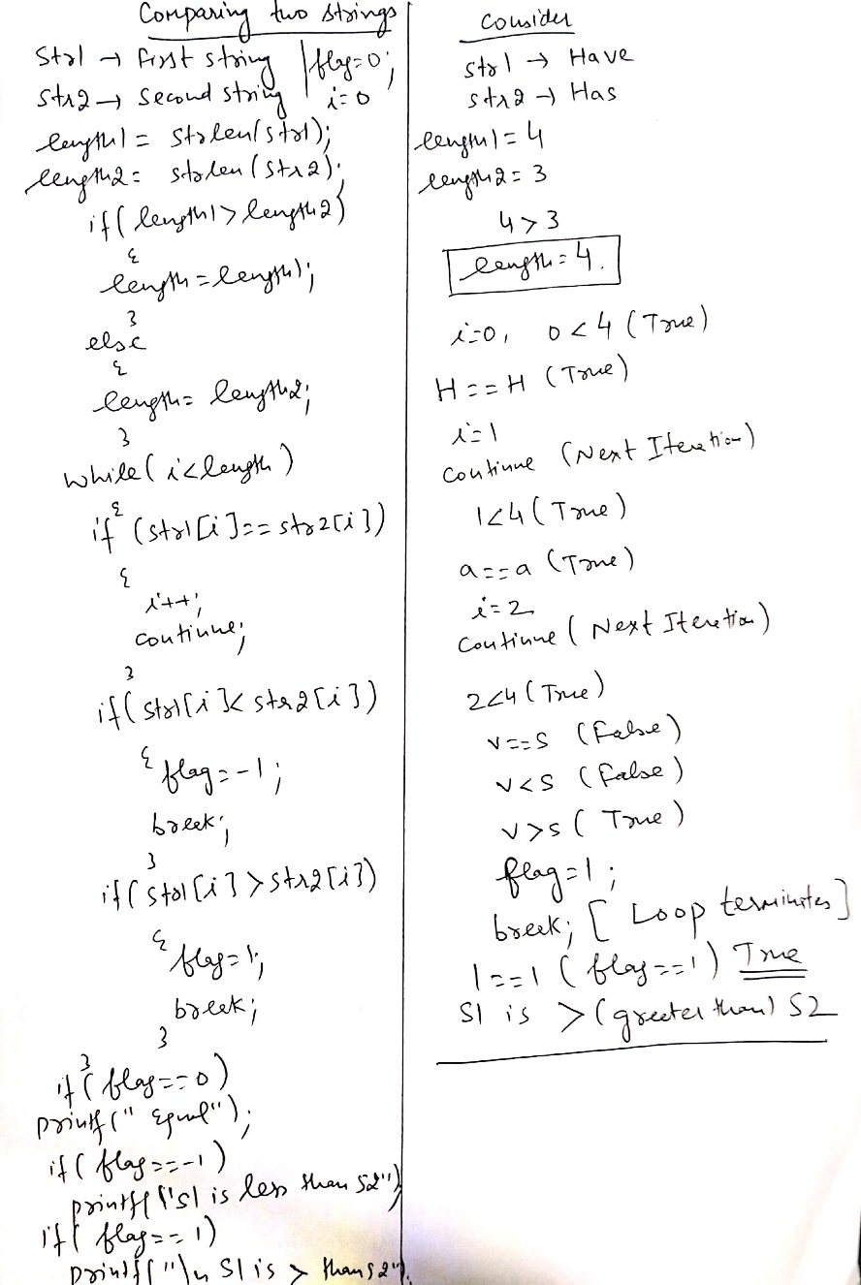
Dry running

Slide 25
WAP to display the reverse of a given string without strrev()/ or inbuilt function
#include<stdio.h>
#include<string.h>
int main() {
char str[100], temp;
int i, j;
printf("\nEnter the string :");
gets(str);
i = 0;
j = strlen(str) - 1;
while (i < j) {
temp = str[i];
str[i] = str[j];
str[j] = temp;
i++;
j--;
}
printf("\nReverse string is :%s", str);
return (0);
}

Slide 26
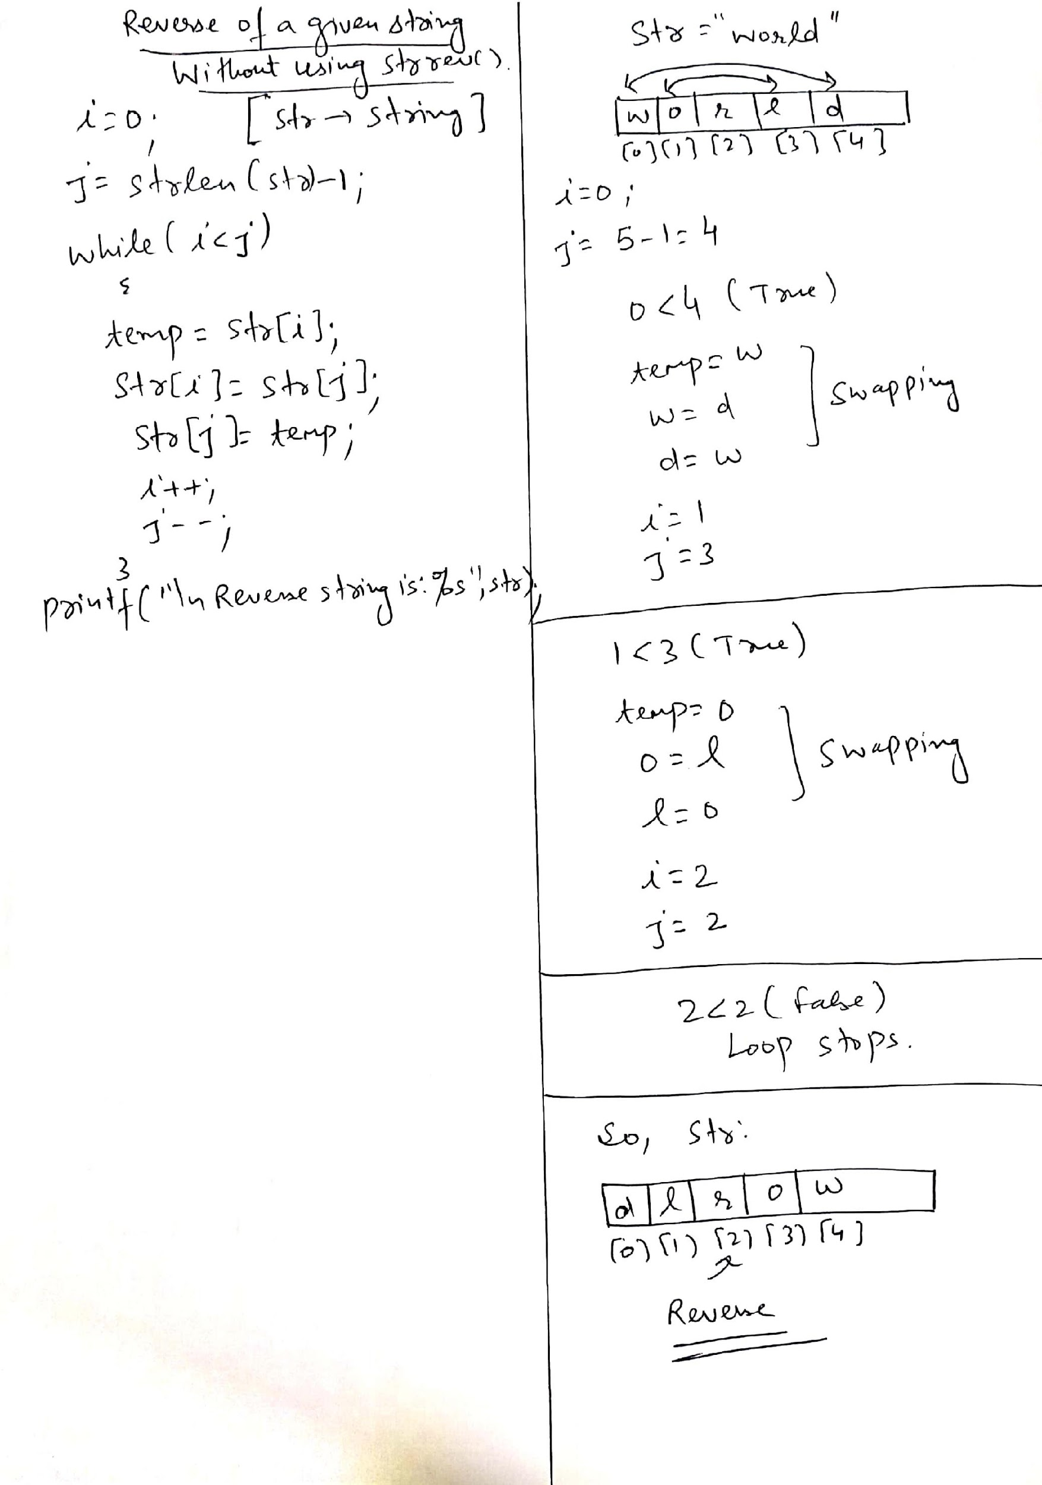
Dry running

Slide 27
WAP to check whether the given string is palindrome or not(without using strrev())
#include<stdio.h>
#include<string.h>
int main() {
char str[100], temp;
char str1[100];
int i, j;
printf("\nEnter the string :");
gets(str);
i = 0;
j = strlen(str) - 1;
strcpy(str1,str);
while (i < j)
{
temp = str[i];
str[i] = str[j];
str[j] = temp;
i++;
j--;
}
if(strcmp(str1,str)==0)
{
printf("\n Given String is Palindrome");
}
else
{
printf("\n Not a Palindrome");
}
return (0);
}

Slide 28
WAP to convert all characters of a given string into uppercase without using strupr()/or inbuilt function
#include<stdio.h>
#include<string.h>
int main()
{
char str1[10];
int i,len;
printf("Enter any string \t");
gets(str1);
len=strlen(str1);
for(i=0;i<len;i++)
{
if(str1[i]>='a' && str1[i]<='z')
str1[i]=str1[i]-32;
}
puts("string in upper is");
puts(str1);
return 0;
}

Slide 29
WAP to convert all characters of a given string into lowercase without using strlwr()/or inbuilt function
#include<stdio.h>
#include<string.h>
int main()
{
char str1[10];
int i,len;
printf("Enter any string \t");
gets(str1);
len=strlen(str1);
for(i=0;i<len;i++)
{
if(str1[i]>='A' && str1[i]<='Z')
str1[i]=str1[i]+32;
}
puts("string in lower is");
puts(str1);
return 0;
}

Slide 30
More programs on strings

Slide 31
WAP to sort the characters of a given string into ascending order
#include<stdio.h>
#include<string.h>
int main()
{
char s[10],t;
int n,i,j;
printf("\n Enter String:");
gets(s);
n=strlen(s);
for(i=0;i<n-1;i++)
{
for(j=0;j<n-i-1;j++)
{
if(s[j]>s[j+1])
{
t=s[j];
s[j]=s[j+1];
s[j+1]=t;
}
}
}
printf("%s",s);
}

Slide 32
WAP to count vowels in a given string
#include<stdio.h>
int main()
{
char x[100];
int i=0,count=0;
printf("\n Enter the string:");
gets(x);
while(x[i]!='\0')
{
if(x[i]=='a'||x[i]=='e'||x[i]=='i'||x[i]=='o'||x[i]=='u'||x[i]=='A'||x[i]=='E'||x[i]=='I'||x[i]=='O'||x[i]=='U')
{
count++;
}
i++;
}
printf("\n Number of vowels in the string are:%d",count);
return 0;
}

Slide 33
WAP to traverse all characters of a given string using pointer to character
#include<stdio.h>
int main()
{
char *g="C Programming";
int length=0,i=0;
while(*g!='\0')
{
printf("%c",*g);//Value at address
g++;//Pointer is incremented by 1 after each iteration
length++;//Variable for counting length
}
printf("\nLength of the string is:%d",length);
return 0;
}

Slide 34
WAP to count total no. of characters and words in a given string
#include<stdio.h>
int main()
{
char x[100];
int i=0,length=0,c=0,w=1;
printf("\n Enter String:");
gets(x);
while(x[i]!='\0')
{
if(x[i]==' ' && x[i+1]!=' ')
{
w++;
}
c++;
i++;
}
printf("\n Total number of characters are:%d, and no. of words are:%d",c,w);
return 0;
}

Slide 35
WAP to demonstrate array of strings in C
#include<stdio.h>
int main()
{
char names[5][10];
int i,n;
printf("\n Enter the number of students:");
scanf("%d",&n);
fflush(stdin);
for(i=0;i<n;i++)
{
printf("\n Enter the name of student %d: ",i+1);
gets(names[i]);
}
printf("\n Names of the students are:\n");
for(i=0;i<n;i++)
puts(names[i]);
return 0;
}

Slide 36
WAP to traverse a string character by character
#include <stdio.h>
int main()
{
char name[]="Hello World"; //string char array
int i=0;
while(name[i]!='\0') //untill null character
{
printf("%c\n", name[i]);
i++;
}//end while
}//

Slide 37
WAP to replace all spaces in a given string with ‘$’[Example for character replacement]
#include<stdio.h>
int main()
{
char x[100];
int i=0;
printf("\n Enter the string:");
gets(x);
while(x[i]!='\0')
{
if(x[i]==' ')
{
x[i]='$';//Character replacement
}
i++;
}
printf("\n String after character replacement is:%s",x);
return 0;
}

Slide 38
Output-1??
#include<stdio.h>
int main()
{
char str[]="Practice MCQ";
printf("\n%d",sizeof(str));
return 0;
}
A. 13
B. 12
C. 11
D. 1

Slide 39
Output-2??
#include<stdio.h>
int main()
{
char str[]="Program";
printf("%c",str[7]);
return 0;
}
A. m
B. Program
C. Compile time error
D. Nothing will be visible

Slide 40
Output-3??
#include<stdio.h>
int main()
{
char str1[]="Good";
char str2[5];
str2=str1;
printf("%s",str2);
return 0;
}
A. Good
B. Garbage value
C. Compile time error
D. Nothing will be visible

Slide 41
Output-4??
#include<stdio.h>
int main()
{
char str1[]="Good";
char *str2;
str2=str1;
puts(str2);
return 0;
}
A. Good
B. Garbage value
C. Compile time error
D. Nothing will be visible

Slide 42
Output-5??
#include<stdio.h>
#include<string.h>
int main()
{
char str[20]="Example";
printf("%d %d",sizeof(str),strlen(str));
return 0;
}
A. 7 7
B. 20 20
C. 20 7
D. 20 8

Slide 43
Output-6??
#include<stdio.h>
#include<string.h>
int main()
{
char str1[20]="Example";
char str2[30]="Exam";
if(strncmp(str1,str2,4))
printf("\nHello");
else
printf("\nWorld");
return 0;
}
A. Hello
B. World
C. Nothing will be printed
D. Compile time error

Slide 44
Output-7??
What will be the output of the program ?
#include<stdio.h>
#include<string.h>
int main()
{
char str1[20] = "Hello", str2[20] = " World";
printf("%s\n", strcpy(str2, strcat(str1, str2)));
return 0;
}
A. Hello
B. World
C. Hello World
D. WorldHello

Slide 45
Output-8??
In below program, what would you put in place of “?” to print “Quiz”?
#include <stdio.h>
int main()
{
char arr[] = "HelloQuiz";
printf("%s", ?);
return 0;
}
A. arr
B. (arr+5)
C. (arr+4)
D. Not possible

Slide 46
Question-9
Which of the following C code snippet is not valid?
(A) char* p = “string1”; printf(“%c”, *++p); (B) char q[] = “string1”; printf(“%c”, *++q); (C) char* r = “string1”; printf(“%c”, r[1]); (D) None of the above

Slide 47
Output-10 ??
#include<stdio.h>
int main()
{
printf(8+"C Programming\n");
return 0;
}
A. mming
B. ming
C. amming
D. gramming

Slide 48
Output-11 ??
//Assume unsigned integer takes 4 bytes
#include <stdio.h>
int main()
{
char *str1 = "Hello";
char str2[] = "Hello";
printf("sizeof(str1) = %d, sizeof(str2) = %d",sizeof(str1), sizeof(str2));
return 0;
}
A. sizeof(str1) = 6, sizeof(str2) = 6
B. sizeof(str1) = 4, sizeof(str2) = 6
C. sizeof(str1) = 4, sizeof(str2) = 4
D. sizeof(str1) = 6, sizeof(str2) = 4

Slide 49
Output-12 ??
Predict the output of the following program:
#include <stdio.h>
int main()
{
char str[] = "%d %c", arr[] = "HelloWorld";
printf(str, 0[arr], 2[arr + 3]);
return 0;
}
A. 72 W
B. H W
C. W H
D. Compile-time error

Slide 50
Output-13??
#include <stdio.h>
int main()
{
char *str="WORLD";
while(*++str)
{
printf("%c",*str);
}
return 0;
}
ORLD
WORLD
RLD
Compile time error

